Slide 1
SIH 2020
AAS
Accidental
Alert System
Better and faster emergency care during accidents and vehicle impact

Slide 2
Process Diagram
RAW Data Collection
01
Hardware Collects RAW Sensor Data ,Location and Forwards To Server
Data Analysis On Server
02
ML Model Predicts Occurrence Of Accident
Raising an Alert
03
Calling the Nearest Hospital And Sharing Accident Details
Informing Victims Connections
04
Informing Victims Relatives/Friends about the incident and location via AAS app.

Slide 3

Occurrence of a Incident
Whenever an Accident Occurs the
Emergency Services Automatically Called
The device forwards raw data to server, after analyzing an automated call is placed to nearest healthcare/Emergency organizations and providing the necessary information about the incident.

Slide 4
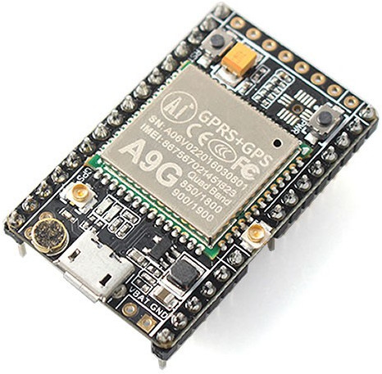
Hardware
approach
Provides real time location
Takes sensor data from various sensors.
Sends data to Server for analysing with ML model.
Takes sensor data from various sensors.

Slide 5
Server Approach
Machine Learning Model
Analyse sensor data using Random Forest classifier.
Finds out if Accident has occurred.
Predict severity of accident.

Slide 6
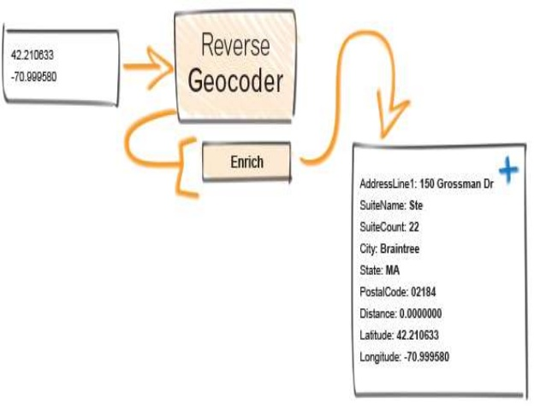
Server Approach
Reverse Geocoding
Convert Geolocation coordinates to Place names.
As shown in Image we obtain Float values as geocoordinates.
This process converts the geocoordinates to human understandable address.

Slide 7

Server Approach
Alert Via Calling
Using maps API services ,nearest Healthcare/emergency organisation details are fetch.
Alert is raised via calling though Cloud/IVR Services.

Slide 8

APP Solution
Alert Of Incident
Gets Current Location
Whenever server predicts an accident there will be an alert in the app.
.The app will fetch the current the current location of the vehicle and display it.
Contents
Performance
Contents
Performance
Contents
Performance
features
User can manage their profile via app
They can check the vehicle fuel/pollution status.
Additional Info About owner and vehicle can be tracked by installing supportive hardware.

Slide 9
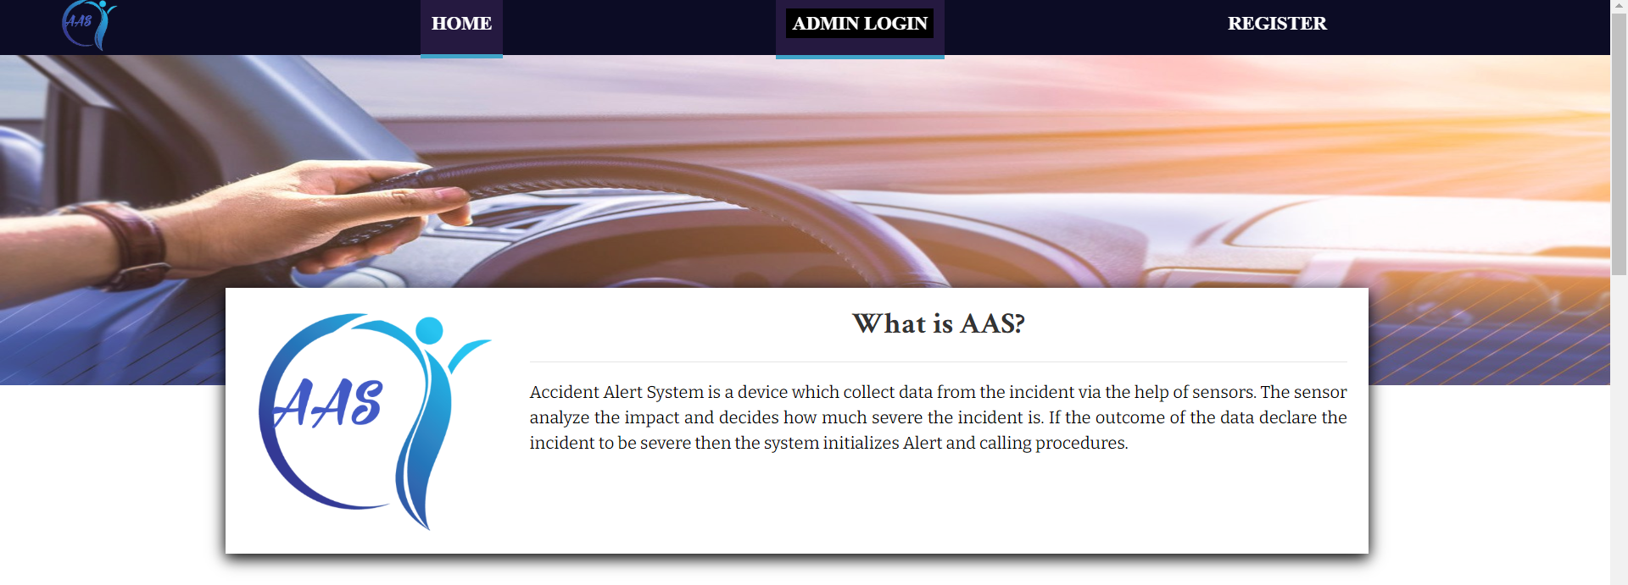
Home Page
3
3
2
2
1
1

Slide 10
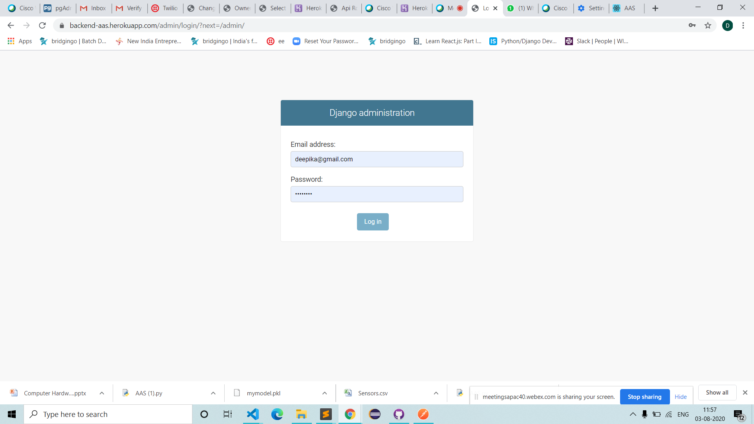
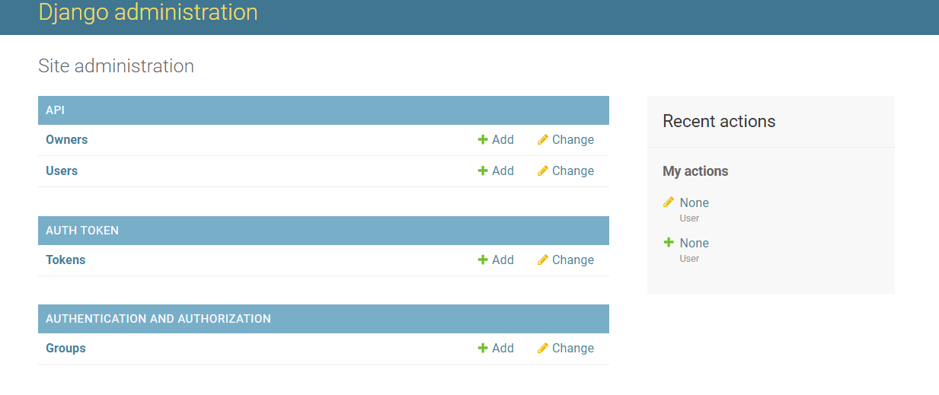
User Registration
3
3
2
2
1
1

Slide 11
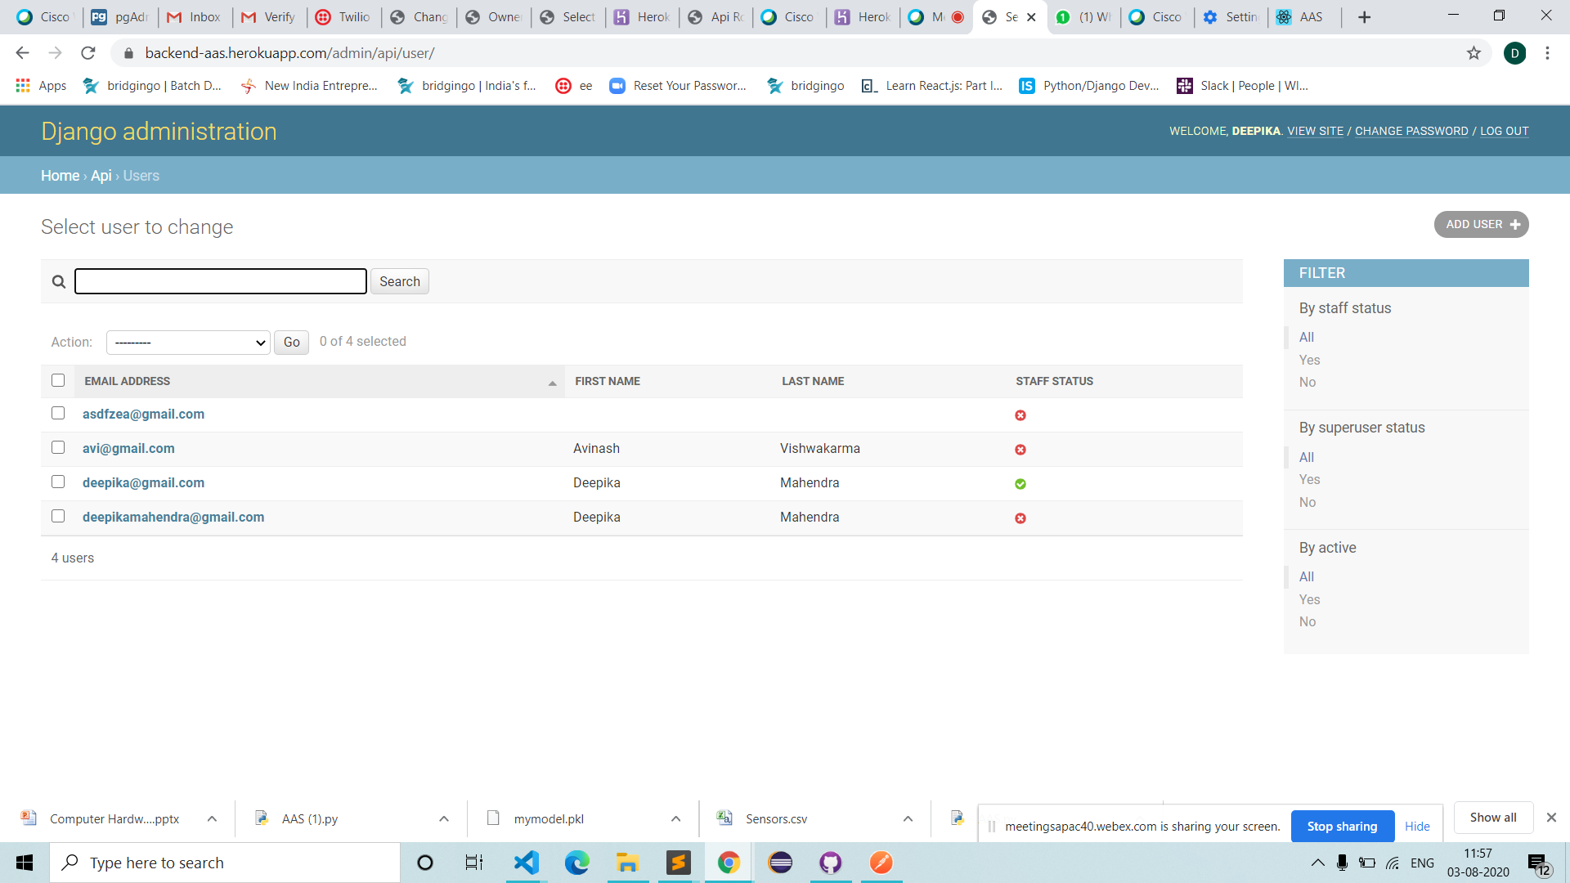
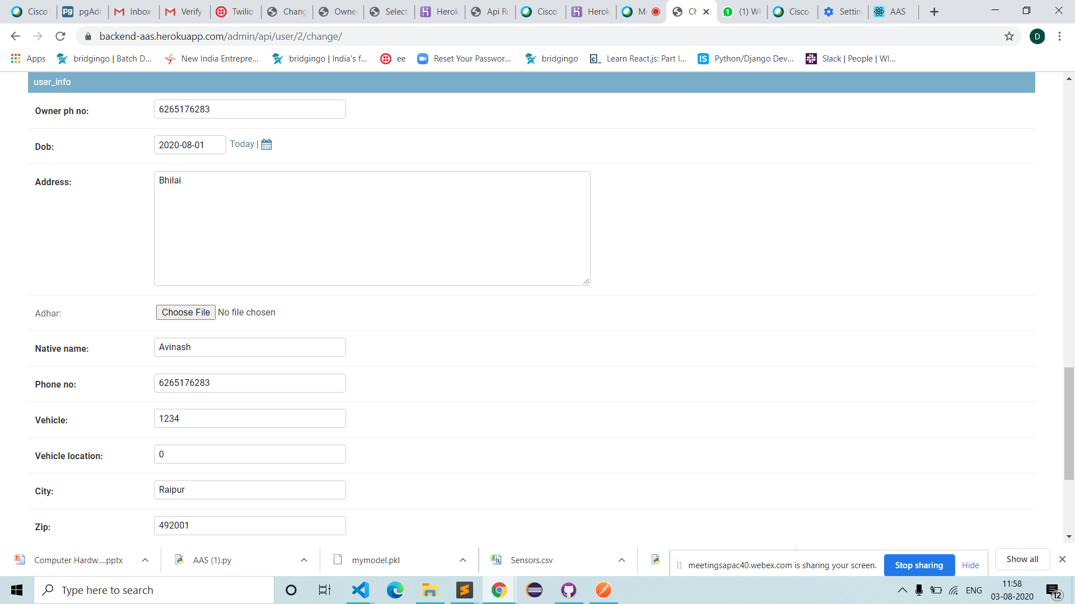
User detail
3
3
2
2
1
1

Slide 12
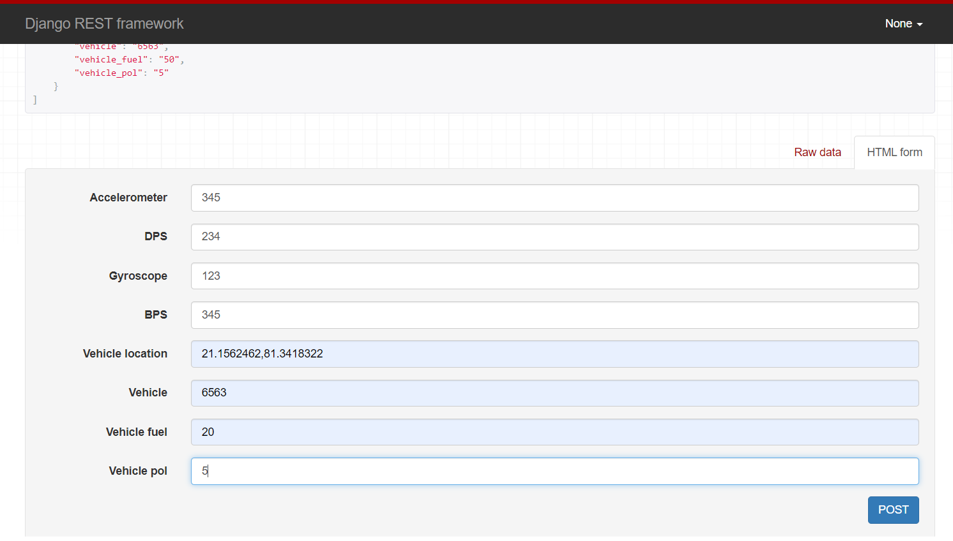
simulation
3
3
This is the device simulation part .
Here we are forwarding data to
server
2
2
1
1

Slide 13
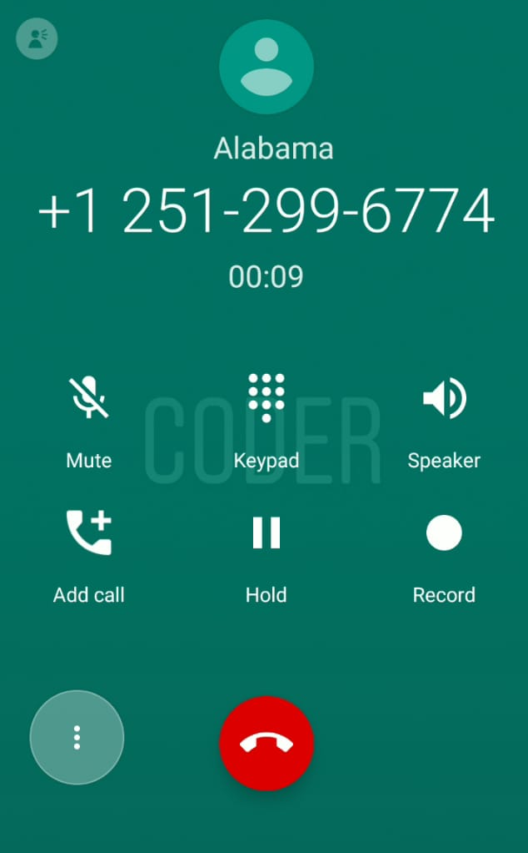
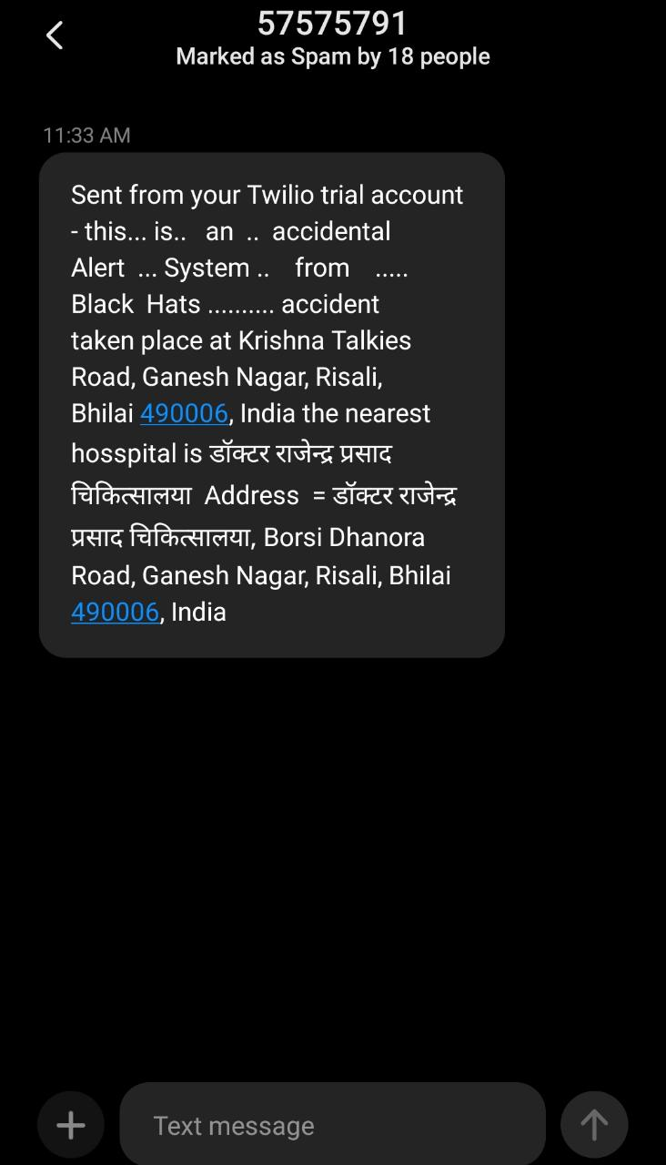
Alert
3
3
2
Call and message
2
1
1

Slide 14
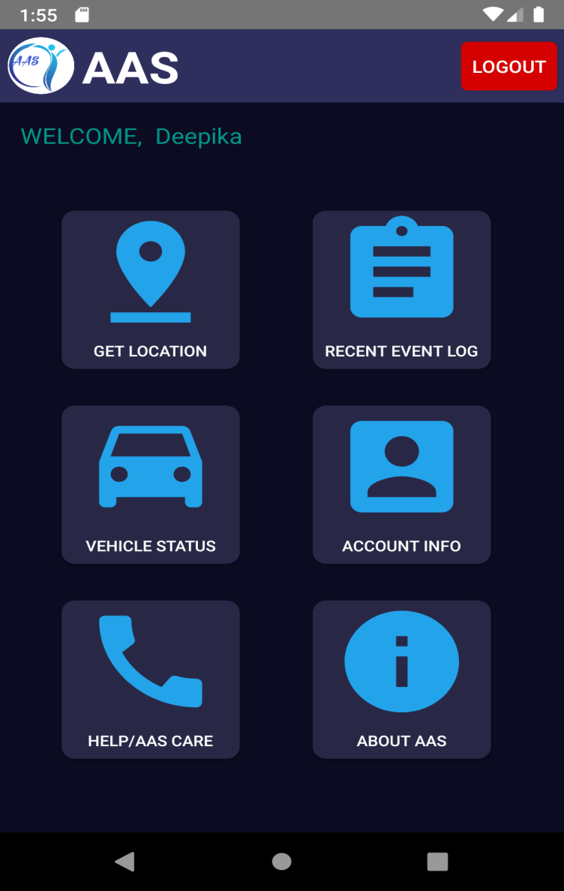
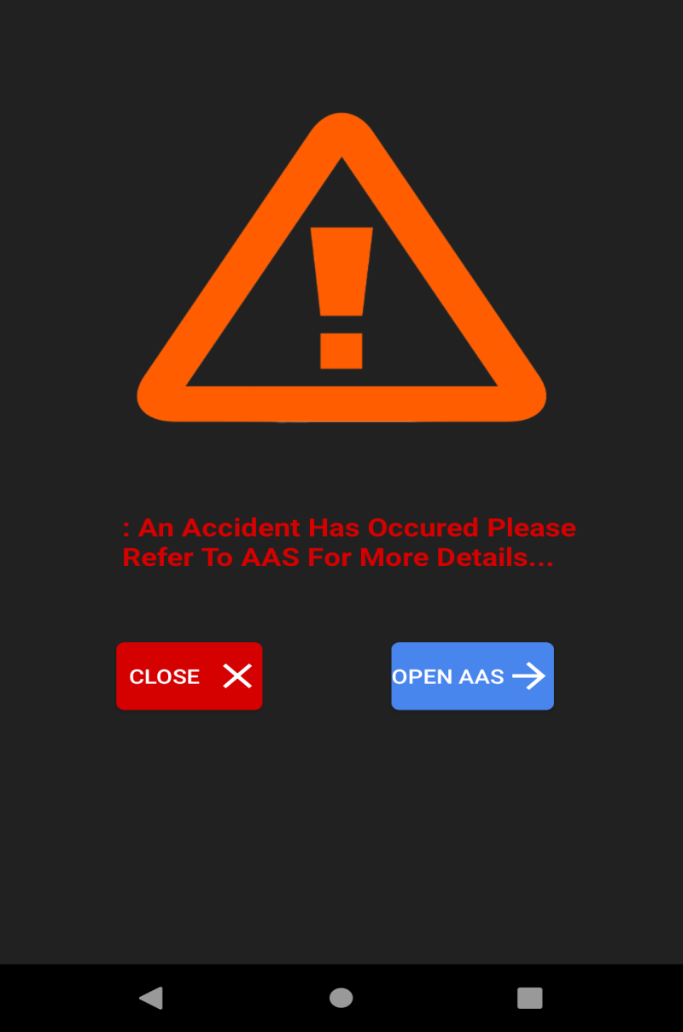
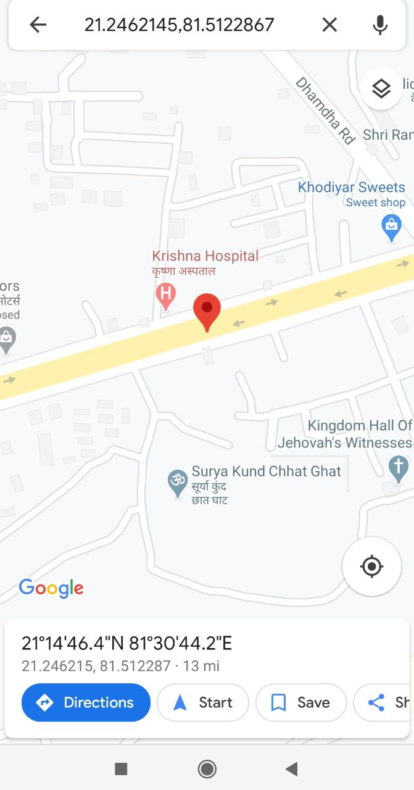
Alert in App
3
3
2
2
1
1
System generated alert in our App

Slide 15
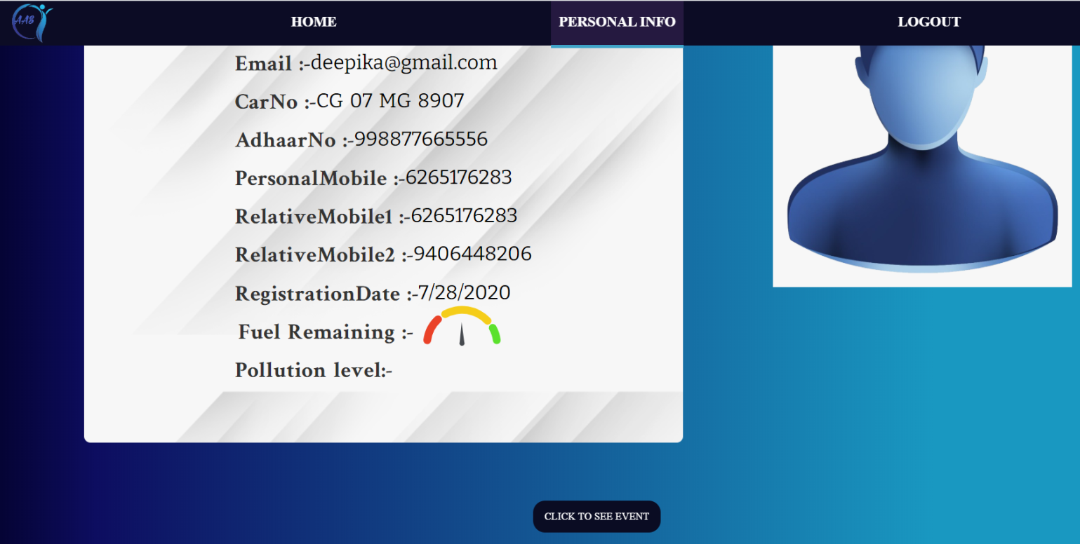
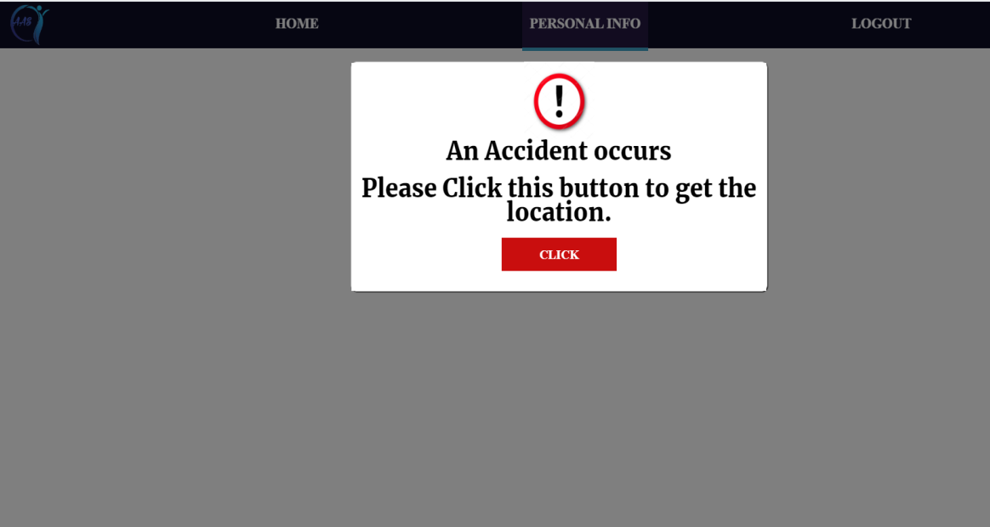
Alert in website
3
3
We can see alert from website also
2
2
In case app is not installed in the phone ,
user can visit website for further details
1
1

Slide 16
THANK YOU

